Slide 1

BABY CRY CLASSIFICATION USING SUPPORT VECTOR CLASSIFIER
TEAM-1

Slide 2
Group Member Information
Chakradhar Jonnalagadda #700741495
Sushma alampally #700743513
Sai Srikanth Narina #700741314
Venkata Ramana Ravuri #700741281

Slide 3
Role/Responsibilities and Contribution in project
Completing the data extraction and data sanitation from the audio files, Splitting the Goals and Objectives, Increment Guidelines tasks. Splitting work into individual tasks and working on it to bring it to closure and later explaining one’s part to all the other members of the team. Repeated the same process for all the team members.
1.Chakradhar Jonnalagadda #700741495 - 25%
2.Sushma Alampally #700743513 - 25%
3.Sai Srikanth Narina #700741314 - 25%
4.Venkata Ramana Ravuri #700741281 - 25%

Slide 4
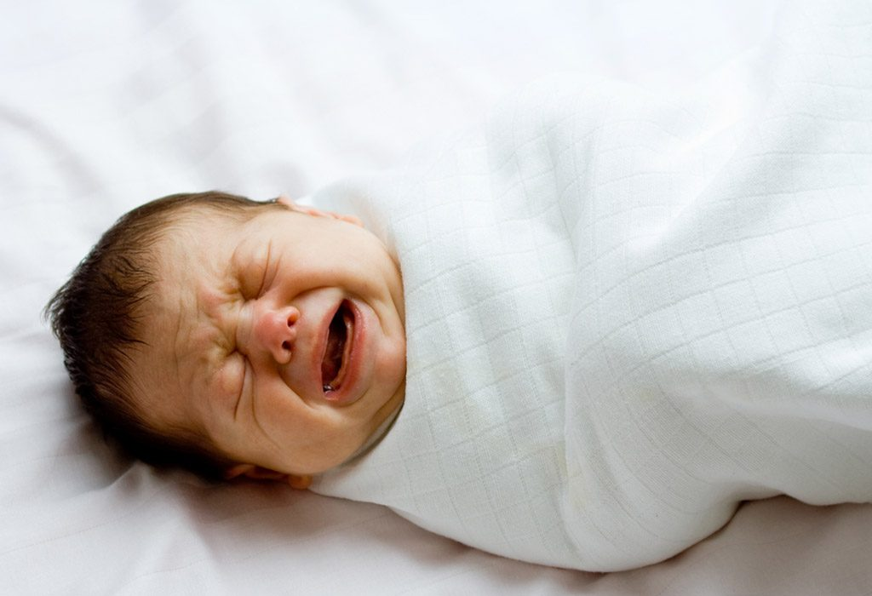
MOTIVATION
The Cry is the sole indication that infants use to indicate their demands. The Smart Baby Monitoring System employs the Cry as a sign for monitoring as well. Cries are the only sign that infants use.

Slide 5






OBJECTIVES
Clipping Audio Files
Feature Extraction from Audio files
Data Preparation
Model Construction
Model Training
Model Analysis

Slide 6

RELATED WORK
Instinctively and spontaneously, infants scream to communicate distressing feelings like hunger, pain, indigestion, discomfort, etc. Research on the causes of baby crying has been ongoing for quite some time. In the 1940s, the first books on the topic were published.
In fact, writers in have investigated newborn crying in an effort to diagnose, for instance, the signs of severe diseases through study of qualitative aspects of the crying.
In fact, people have investigated newborn crying in an effort to diagnose, for instance, the signs of severe diseases through study of qualitative aspects of the crying. Despite this excitement about the potential of studying newborn screams in early illness identification, scientists did not limit themselves to this area. It has also been of some interest to try to classify the causes of crying.

Slide 7
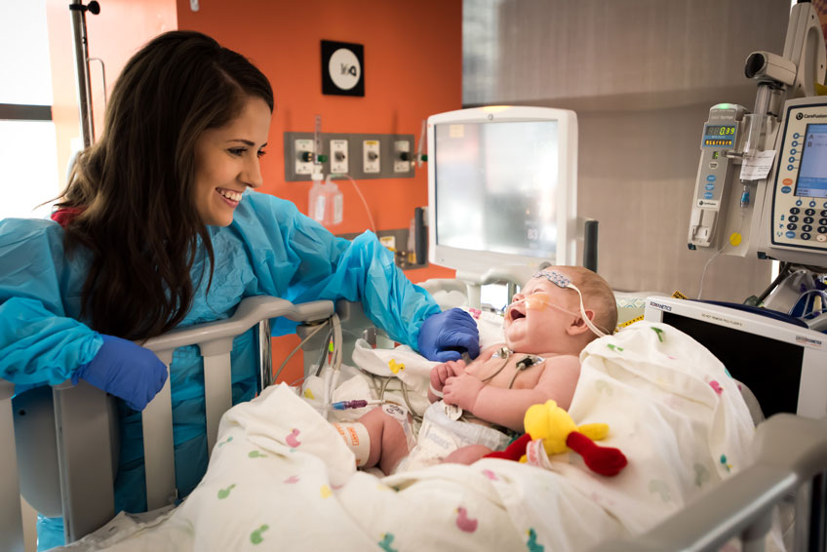
PROBLEM STATEMENT
There are a significant number of births that take place in hospitals each day, yet there are less staff members available to care for the newborns. A significant number of face-to-face interactions are required of childcare facility employees.
The nurses who work in these facilities have a natural ability to determine the requirements of the children based on the cry sounds that they make.

Slide 8

AI Solution
We have designed an AI model which can classify the baby cries.
The model classify them into following categories.
Noise
Laugh
Cry
Burping
Hungry
Tired
Discomfort

Slide 9
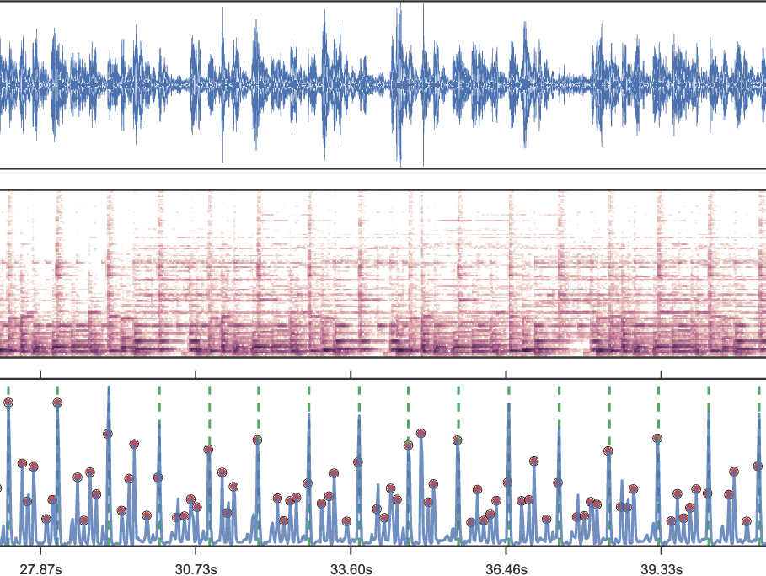
Data Preparation
A total of 500 MS clips were created from the obtained data from each facility. The BSR scale has four levels, while the BCR scale has five.
Librosa python package be used to parse audio files for features.

Slide 10

Proposed Solution
we build a pipeline for training the model, which comes after data preparation is finished. Models for both the BSR and BCR are trained with separate data sets.
Baby speech recognition (BSR) is trained with a variety of ambient and baby-generated sounds, whereas baby cry recognition (BCR) is trained with solely the latter.
Data is divided into a training set (80%) and a testing set (20%). The pipeline normalizes the data before feeding it into the SVM classifier.

Slide 11
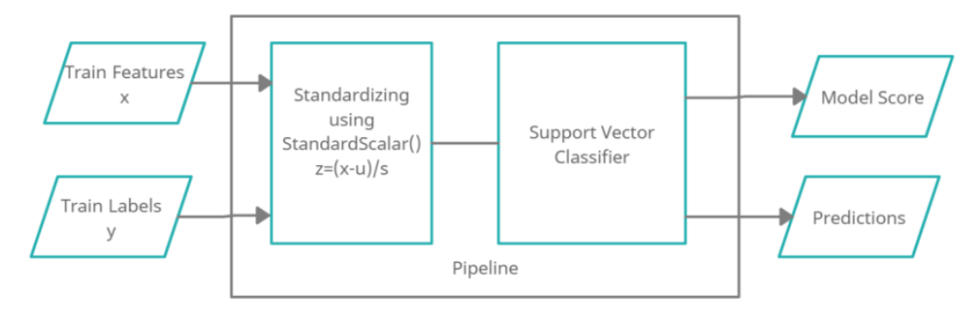
Pipeline

Slide 12

Results
The k-fold cross validation showed that the BSR was 98% accurate and the BCR was 74% accurate.

Slide 13
References
[1] R.G. Barr, N. Fairbrother, J. Pauwels, J. Green, M. Chen and R. Brant, "Maternal frustration emotional and behavioural responses to prolonged infant crying", Infant Behavior and Development, vol. 37, no. 4, pp. 652-664, 2014.
[2] H.C. Lin and R. McFatter, "Empathy and distress: Two distinct but related emotions in response to infant crying", Infant Behavior and Development, vol. 35, no. 4, pp. 887-897, December 2012.
[3]P. Dunstan, Calm the crying: The Secret Baby Language, pp. 16-17, 2012
[4] H.L. Golub and M.J. Corwin, "Infant Cry: A Clue to Diagnosis", Pediatrics, vol. 2, no. 197, pp. 69, 1982.
[5] L.L. LaGasse, A.R. Neal and B.M. Lester, "Assessment of infant cry: acoustic cry analysis and parental perception", Developmental Disabilities Research Reviews, vol. 11, no. 1, pp. 83-93, 2005.
[6] M. Uluba, H. Uzun and D.A. Senses, "A newborn with Cornelia de Lange syndrome: a case report", Cases J, vol. 1, pp. 329, 2008.
[7] H. Nakayama, "Development of infant crying behavior: A longitudinal case study", Infant behavior & development, vol. 33, no. 10, pp. 463-71, 2010.

Slide 14

Thank You

